Slide 1
EARLY YEARS SLIDESHOW
Notes:
This PowerPoint slideshow is suitable for early years teachers to use in the classroom or during a self-guided tour of the exhibition in the Gallery of Modern Art (GoMA). It has been designed for use with data projectors, school interactive whiteboards, or as a colour print-out.
The slideshow explores how contemporary Australian artists address ideas of home and transport. It provides links to artist projects in the Children’s Art Centre which also explore similar concepts.
The notes sections provide background reading for teachers, and include questions (in italics) which can be read aloud when discussing each of the art works. Additional information about ‘Contemporary Australia: Optimism’ can be found in the exhibition catalogue, including essays on each of the artists and a full list of works.
The curriculum information included in this resource has been developed from the:
Early Years Curriculum Guidelines for use in preparatory classes (© The State of Queensland, Queensland Studies Authority, 2006)
Assessment and Reporting Framework for The Arts, focusing on learning and assessment around the Essential Learnings and Standards for Visual Art and Media (© The State of Queensland, Queensland Studies Authority, 2007).
1

Slide 2
Home and transport
Home can be a building that you live in, or the environment around you. Home can also be somewhere that is special to you.
Notes:
CURRICULUM INFORMATION
(NB: Relevant artists for specific curriculum areas are noted in brackets.)
This slideshow presentation will provide early years students with an understanding of:
the ways contemporary Australian artists consider ideas about home, forms of transport, and the environment.
EARLY YEARS CURRICULUM GUIDELINES
Active learning processes: Investigating environments
Children will think and inquire by:
investigating features of, and ways to sustain, environments (e.g. Emily Floyd).
Active learning processes: Imagining and responding
Children will generate, represent and respond to ideas, experiences and possibilities by:
experimenting with materials and processes in a variety of creative, imaginative and innovative ways (e.g. Tom Moore)
discussing and responding to the qualities of their own and others representations, experiences and artistic works (e.g. Kayili artists).
2

Slide 3
Home and transport continued
Home can be a building that you live in, or the environment around you. Home can also be somewhere that is special to you.
Notes:
ESSENTIAL LEARNINGS BY THE END OF YEAR 3
Visual Art
Visual Art involves using visual arts elements, concepts, processes and forms (both 2-D and 3-D) to express ideas, considering particular audiences and purposes, through images and objects.
Students will explore the ways:
regular, irregular, open, enclosed, overlapped and adjacent shapes are used to create categories and positions (e.g. Sean Cordeiro and Claire Healy)
texture is used to create variation and repetition (e.g. Kathy Temin uses soft and fluffy fabrics and fur).
Media
Media involves constructing meaning by using media languages and technologies to express representations, considering particular audiences and purposes.
Students will explore the ways:
still and moving images, sounds and words are used in media texts (e.g. Tom Moore)
media techniques and practices, including cropping; printing; recording/capturing; and sequencing images, sounds and words, are used to create media texts (e.g. Tom Moore)
representations in media texts can be either real or imagined, and are created for particular audiences and purposes (e.g. Patricia Piccinini).
3

Slide 4
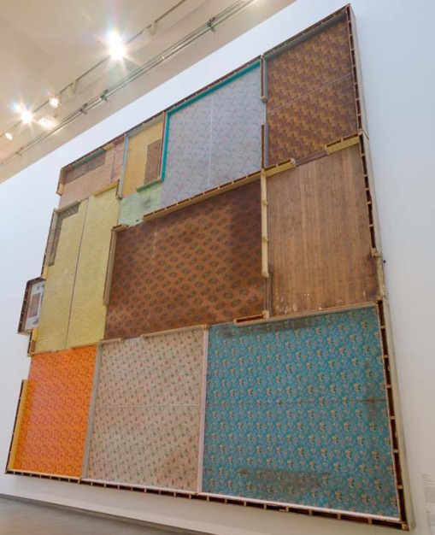
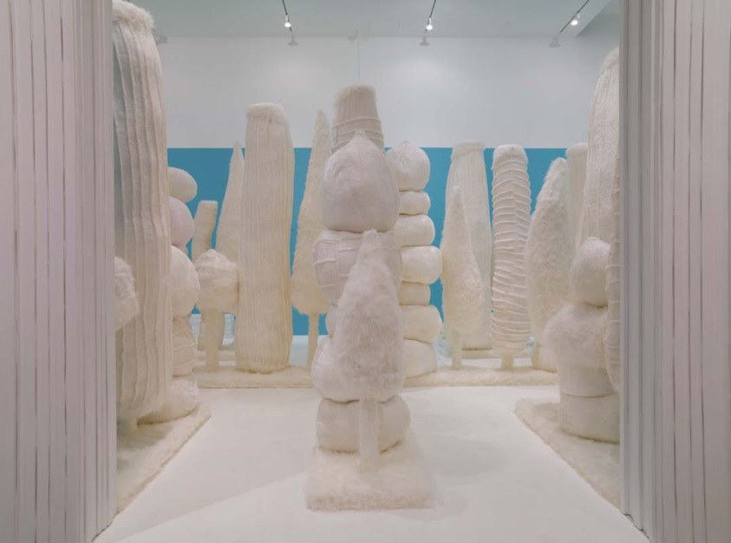
Compare and contrast
Sean Cordeiro and Claire Healy explore the physical side of homes and houses, whereas Kathy Temin explores the idea of place through the environment and memory.
Sean Cordeiro
Claire Healy
Not under my roof
Kathy Temin
My monument: White forest 2008
Photograph: Ray Fulton and Natasha Harth
Notes:
Explore the works in the exhibition, and visit the Children’s Art Centre to explore the interactive art works Rock the house and Arrange your own trees designed by the artists.
Sean Cordeiro and Claire Healy
When Sean Cordeiro and Claire Healy make art, they like to find different ways of thinking about homes, buildings and personal belongings. For instance, once they gathered all the things that belonged to them and stacked them into a huge glass house inside an art gallery!
For the ‘Contemporary Australia: Optimism’ exhibition, Cordeiro and Healy have removed the entire floor of an old Queensland house and installed it right up the wall for the work art Not under my roof 2008.
Not under my roof 2008 investigates the surface versus the ‘interior narrative’ of a home. The home, called Linaine, was formerly a farm residence at Millmerran, 220 kilometres south-west of Brisbane. Vernacular Queensland architecture of timber and tin housing originated in the 1850s, when the newly established sawmill industry made timber for walls and floors affordable; tin was used for roofing due to its transportability and ability to withstand summer storms. Although the ‘Queenslander’ has since evolved, timber and tin have remained signatures of suburban and rural Queensland. (Julie Walsh, ‘Sean Cordeiro and Claire Healy: Not under my roof’, in Contemporary Australia: Optimism [exhibition catalogue], Queensland Art Gallery, Brisbane, 2008, pp.58–61.)
In Cordeiro and Healy’s interactive activity in the Children’s Art Centre, Rock the house, children consider how to depict a dream home or their own home by creating miniature versions of a house, caravan, or castle.

Slide 5
Compare and contrast
Kathy Temin
My monument: White forest 2008 Photograph: Ray Fulton and Natasha Harth
Notes:
Kathy Temin
Kathy Temin often includes images of trees in her art. Her art work for ‘Contemporary Australia: Optimism’, My monument: White forest 2008, is a maze of fluffy white trees. People are invited to find their way through the maze and experience how it feels to be surrounded by a white fluffy forest.
My monument: White forest 2008 includes heavily stylised cartoon-like trees, like the endangered Truffula forest in Dr Seuss’s The Lorax, sitting white against a sky-blue background, referencing Wedgwood reliefs and architectural friezes. The beauty and flourish of decoration opens up a fantasy realm of excess, yet Temin’s soft materials are earthily physical, her structures movingly wonky and fragile. Her work conjures a place that is simultaneously present and absent, real and imagined. We make our world with what we have, although our capacity for hope is limitless.
Trees hold special meaning for Temin: they remind her of the forests in Europe — the place that was once her family’s homeland; and also they make her think of the new place where her family migrated to after World War Two to start a new life — Australia. (Russell Storer, ‘Kathy Temin: Bringing it all back home’, in Contemporary Australia: Optimism [exhibition catalogue], Queensland Art Gallery, Brisbane, 2008, pp.220−3.)
In Temin’s interactive activity in the Children’s Art Centre, Arrange your own trees, children are invited to create their own miniature landscape with fuzzy-felt using different sized trees designed by the artist.
Questions for discussion
Think about your home or a building that you visit a lot. What would it look like if it was turned inside out and all of the furniture and things were removed?
What kinds of things does a ‘home’ have inside? What do we need inside a house so that we can live there? What is a home made out of? Brainstorm the way that places other than a ‘house’ can be a ‘home’.
Can you think of any places with trees that you like to visit? Are there any ‘outside’ places that you have good memories of?

Slide 8
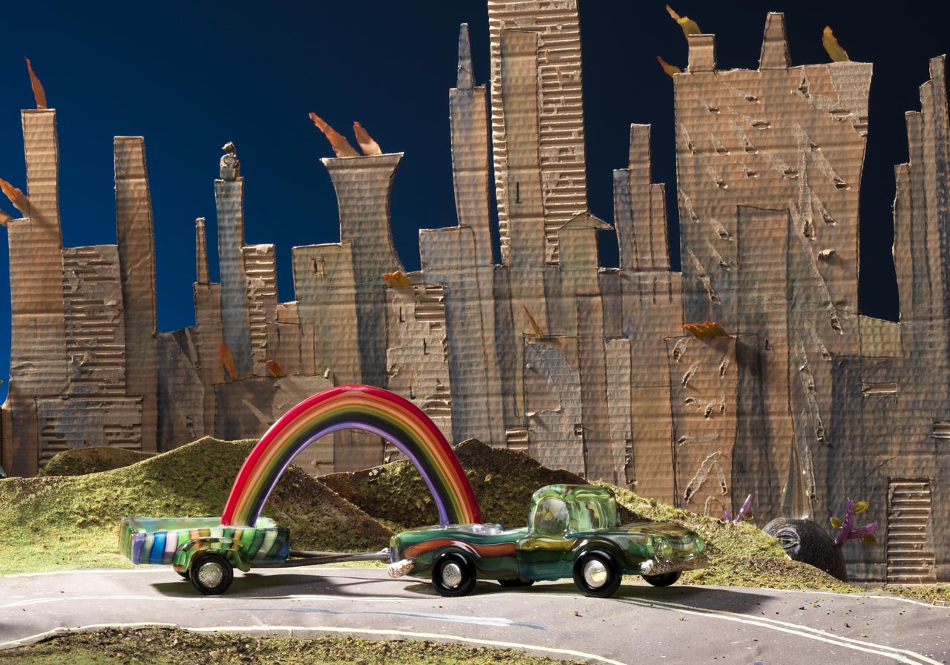
What kind of transport would you like to use to travel around your home town?
Tom Moore Getting the truck out of there
Autoganic 2001–08
With: Autoganic, everything explodes 2008
Notes:
Tom Moore
Tom Moore’s art work contains a menagerie of bizarre and wonderful creatures which interact in a mixed-media environment to create a unique ‘theatre of glass’. While there is an emphasis on the absurd, this is not Theatre of the Absurd, where life is portrayed without meaning or reason. Rather, this is a theatre of amazement, delight and even hope.
Tom uses glass, cardboard and film animation to create his own world of hybrid plant–animal forms — these glass creatures also act as modes of transport through the dreamlike landscape. The city that is home to Tom’s hybrid creatures has many similarities to ours. His naive stage set conveys a powerful sense of the insignificance and impermanence of our place in the world, but also implies the childlike joy and possibilities of life.
(Michael Hawker, ‘Tom Moore: Theatre of glass’, in Contemporary Australia: Optimism [exhibition catalogue], Queensland Art Gallery, Brisbane, 2008, pp.150−3.)
Questions for discussion
What animals and plants do you see in Moore’s art work?
What animals and plants do you have at home?
What sort of plant–animal creature would you like to create?

Slide 9
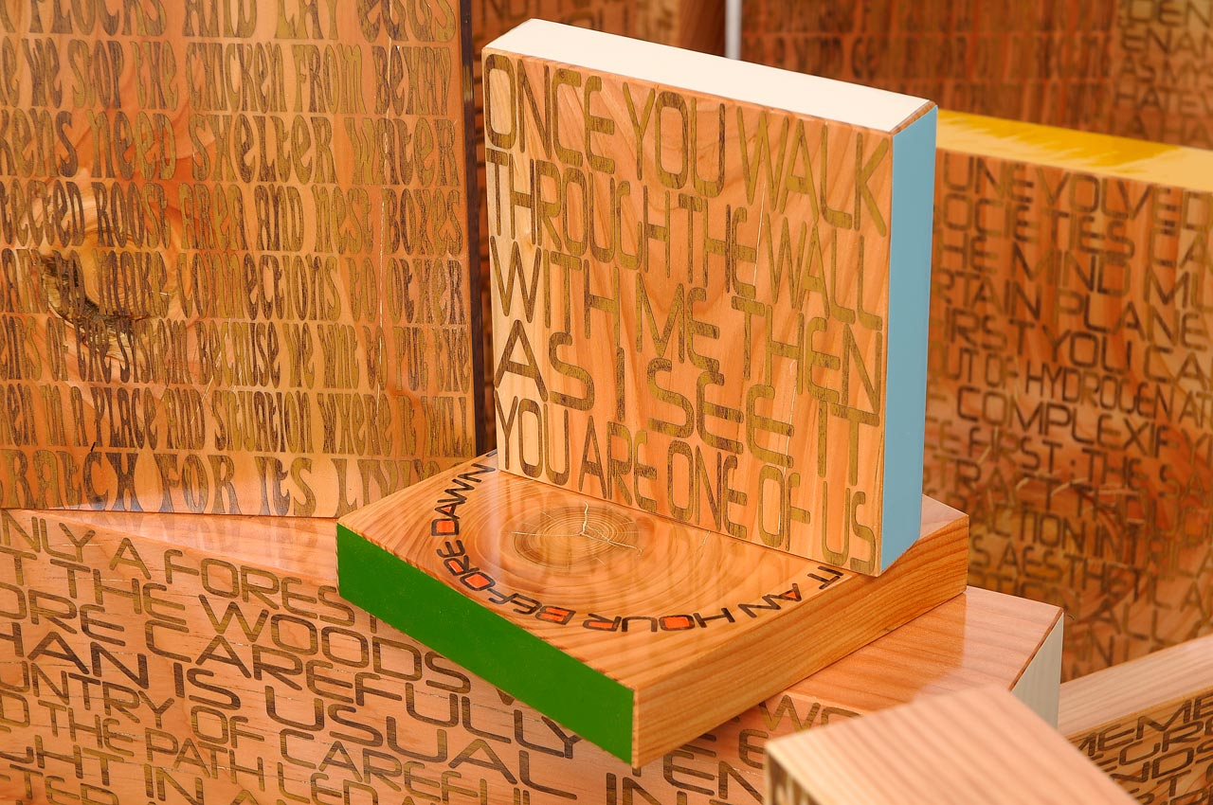
What sort of plants would you like to have growing at your house?
Emily Floyd
Permaculture crossed with feminist science fiction 2008
Notes:
Emily Floyd
Emily Floyd’s art work combines the two ideas of permaculture gardening and feminist science fiction books. Floyd’s work links the concept of optimism to questions around the environment.
In Floyd’s interactive activity in the Children’s Art Centre, Make a manifesto, she has drawn ideas from an Australian permaculture manifesto that tells us how to grow and look after plants. This type of gardening is based on the way plants grow together naturally: there is no waste, little work to do and everything is naturally recycled.
Floyd would like you to make your own art manifesto and write or draw your ideas about what you think art should be. Then, with scissors, create paper mulch from printed art manifestos and germinate new life by planting wheatgrass seeds. You can contribute your plant pot to the indoor permaculture garden or take it home in a biodegradable bag and grow your seeds on a windowsill.
Questions for discussion
What are some different plants that you have growing at home?
How do you look after the plants in your garden?
Can you eat any of the plants in your garden?

Slide 11
Can you remember some of the ideas these artists had about home and transport?
What do you think homes and transport will look like in the future? What will stay the same? What will be different?
Notes:
Reflection exercise
List the key points on a blackboard for the students to reflect upon and consider.
Other reflecting exercises
Make several ramps of different heights for your students to roll their toy cars on. Ask them which one makes the cars go faster. Together, problem-solve the reasons why.
Ask the students to imagine a future where nature and technology are more connected. How will this affect the way we live?
11

Slide 12
Classroom activity suggestions
Notes:
Knowledge and understanding
What does your home mean to you? Invite your students to bring one item from home which best describes where they live.
Brainstorm all the rooms in a house and their purpose/s. Show a house plan (i.e. aerial view) and point out the way the rooms are represented.
Talk to your students about how people live in different types of homes, e.g. Queenslander, stucco, brick or apartment block. What do all homes have in common? Some ideas could include: kitchens, bedrooms, water, etc. What about emotions such as love, comfort etc.?
Discuss some of the reasons people might have to leave their homes (i.e. migration, war, house sold). If you had to move house, what would you miss the most?
Creating
Engage the students in a drawing project. Ask them to select a house and sketch it from both the inside and outside. Discuss what the different perspectives reflect about the inhabitants who live there.
Invite the students to create a model of their ideal home. Consider location, number of rooms, outdoor area etc. How would living in this home make you feel?
Discuss how the Kayili artists use car bonnets found in the Western Desert as the base for many of their paintings. What item from your home would you use to create a work of art with? What does this object reveal about you and where you live?
Presenting
Brainstorm the forms of transport available today. What are the advantages and disadvantages of each? Invite the students to create a new form of transport which addresses all of the advantages listed. What sounds would the transport make?
Inspired by Tom Moore’s diorama, use a digital camera to present a dreamlike scene from a futuristic place. First, invite the students to create the creatures and props for the backdrop, then take a photograph.
Responding
Discuss a new way of controlling traffic on the roads. Encourage the students to experiment using toy cars. Propose new traffic rules and road signs or systems to control the traffic on the roads. As a class, vote which system you think is best.
Debate some ways the students could help towards preserving the environment and initiating their own conservation project, e.g. planting in the school yards, recycling system for lunch wrappings.
12

Slide 13
List of art works
The art work captions are listed below in the order they appear in the PowerPoint.
Sean Cordeiro and Claire Healy
Not under my roof 2008 Found flooring wood, linoleum carpet Dimensions variable site specific work for ‘contemporary Australia: Optimism Courtesy: The artists
Kathy Temin
Australia b.1968
My monument: White forest 2008
Steel, acrylic, fabric, wood, MDF board
Trees: 351 x 1073 x 677cm (irreg.);
4 benches: 42 x 310 x 45cm (each); 400 x
1373 x 860cm (overall installed, variable)
Collection: The artist
A Kayili artist at work in Patjarr, 2007
Image courtesy: Michael Stitfold,
Kayili Artists Cooperative
The V2 Series Holden Monaro automobile from
which Thomas Meadowcroft took audio samples
for the sound installation Monaro Eden 2008
Photograph: Natasha Harth
Patricia Piccinini
Sierra Leone/Australia b.1965
The stags 2008
ABS plastic, automotive paint, plastic,
stainless steel, leather, rubber tyres, ed. 1/3
196 x 224 x 167cm
Collection: The artist
Tom Moore
Australia b.1971
Getting the truck out of there Autoganic 2001–08
Hot-joined, blown and solid glass; hot-joined
solid glass with mixed media; hot-joined,
blown and solid glass with steel and silicon;
hot-joined, blown and solid glass with spanner;
charcoal and watercolour on cardboard;
charcoal and watercolour with solid glass
components on cardboard
Installed dimensions variable
Collection: The artist
With:
Autoganic, everything explodes 2008
Animation: 6:21 minutes, colour, sound, ed.5/9
Animated from digital photographs
Glass and mixed media: Tom Moore
Photographs: Grant Hancock
Digitalanimation and stereo soundtrack: Nigel
Koop
Collection: The artist
Emily Floyd
Australia b.1972
Permaculture crossed with feminist science fiction 2008
Laminated timber, timber, vinyl, polyurethane varnish
244 x 1790 x 580cm (installed dimensions variable)
Collection: The artist
Notes:
13

Slide 14
Sponsors

